Slide 1
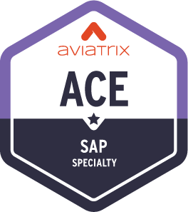
Customer Case Studies
S4/HANA Self Managed Case Studies
S4/HANA MSP Case Study

Slide 2
Case Studies
All-in-All

Slide 3
A large retail
Challenges
Retail has Kubernetes clusters using 172.17.0.0/16 CIDR, which is same with AWS-EKS deployment
SAP front-end hosted environment uses random IP in 10.0.0.0/8 range. SAP cannot guarantee if the servers, which need to connect, use smaller/fixed ranges
Challenge is to connect two SAP environments (B2B and B2C) back to their hosted setup. All SAP hosted sites are in 10.0.0.0/8
Solution
Dedicated SAP landing Spoke VPC. Each EKS VPC connects to Aviatrix Transit GW in HPE mode
Connection between SAP VNG and standalone Aviatrix GW in SAP landing Spoke VPC. Use Aviatrix customer mapped NAT to connect
Advantages
Provide a dedicated/single place (Aviatrix Standalone GW) to implement NAT – easy to control
Connect EKS spoke with HPE to provide high throughput
Manny to Manny address translation to support thousand of connections
Allow customer to add additional EKS clusters without altering the NAT configuration after deployment

Slide 4
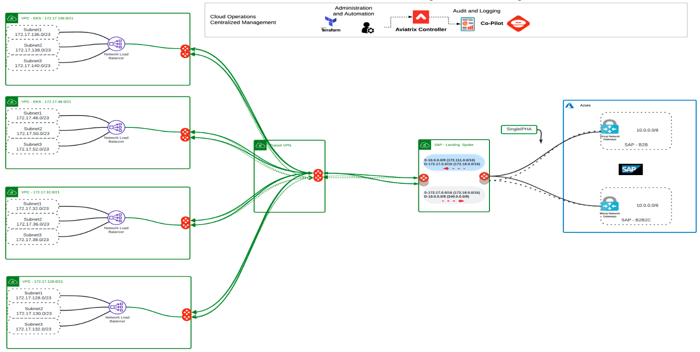
A large retail

Slide 5
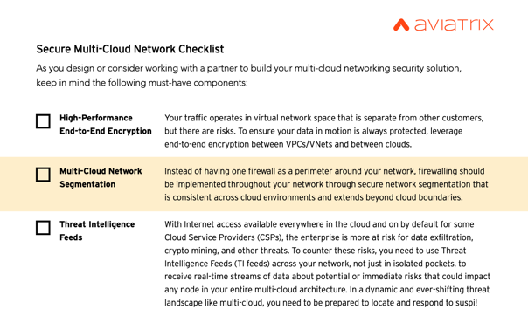

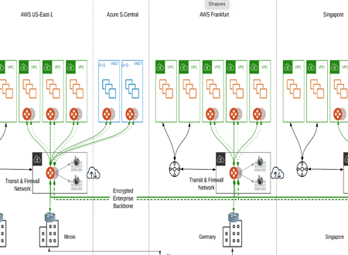
Want to learn more?
ACE
Multi-Cloud Networking
Certification
Intelligent Cloud Network Checklist
https://aviatrix.com/resources/ebooks/security-checklist
Schedule a Customized
Architectural Design Session
Self-Paced &
Instructor-Led
Classes Available
https://aviatrix.com/#live-chat
https://aviatrix.com/ace

Slide 6

Aviatrix Certified Engineer (ACE)
COMMUNITY
https://aviatrix.com/ACE
https://community.aviatrix.com

Slide 7
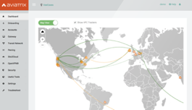
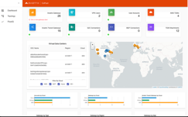
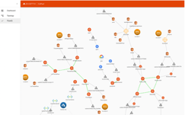
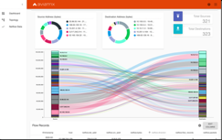









Aviatrix
Controller
Aviatrix CoPilot
Consistent Secure Network and Automation
VPC
VPC
VPC
VPC
VNET
VNET
VPC
VPC
VCN
VCN
Region 1
Region 2
Private Interconnect

